Slide 1



Telstra Data Normalisation Team Koala
Luke Hawkins
Luke Joel Ishan
Nikunj Daniel
Notes:
Introduction
Hi. We are team Koala and we did the Telstra Data Normalization Project. Our team consists of 5 members that would be presenting today.

Slide 2
The Problem: Data Normalisation
Thousands of devices
Variety of formats
Security analysis requires data normalization
Must Normalize to standard schema
Notes:
Every second, thousands of devices log information all with a variety of different formats. This information is crucial for security analysis requiring data normalisation. Each log has to be normalised to a standard schema before they can be analysed.

Slide 3


The Process: Data Normalisation
Constructing Mappings
Normalising Live Data
Notes:
We approach this process by splitting the problem domain of normalisation into two sections.
The Construction of Mappings, and the Normalisation of live data.

Slide 4

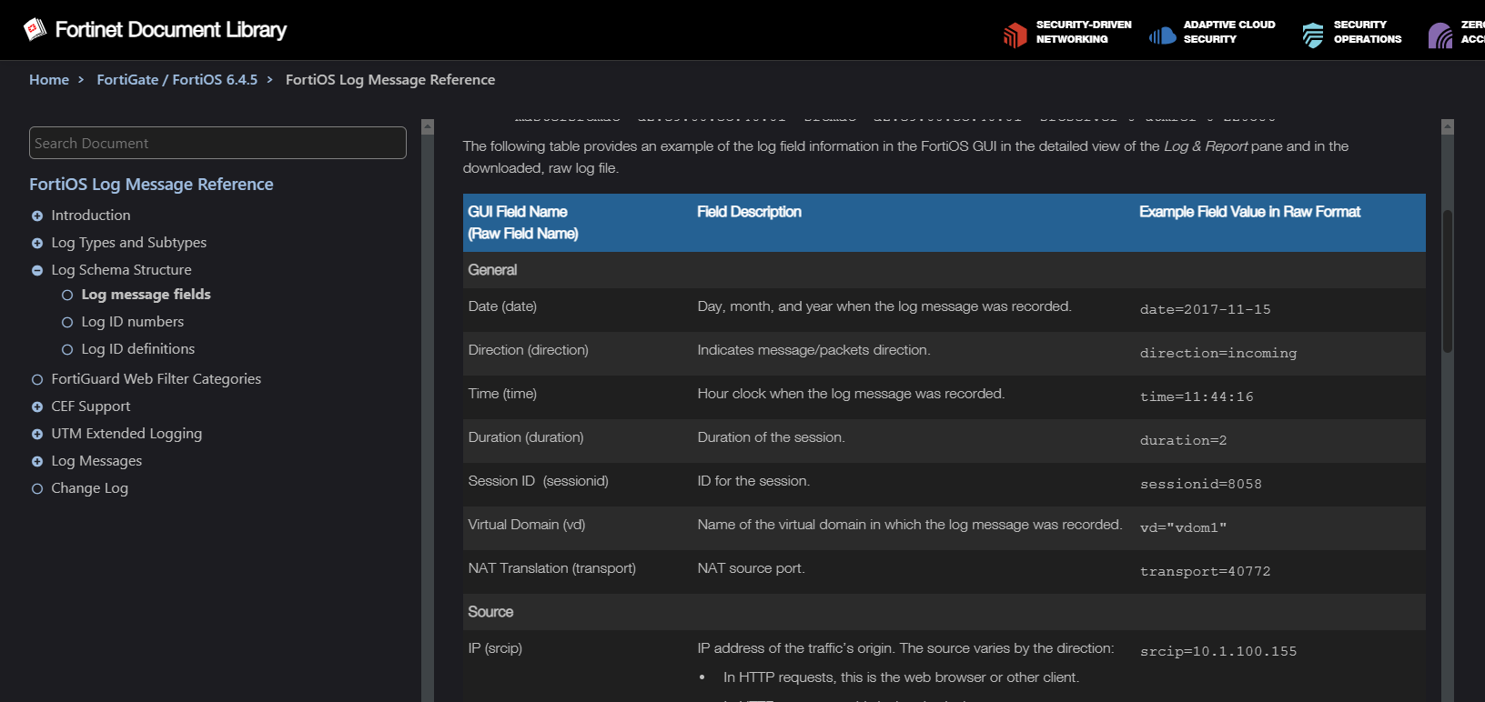
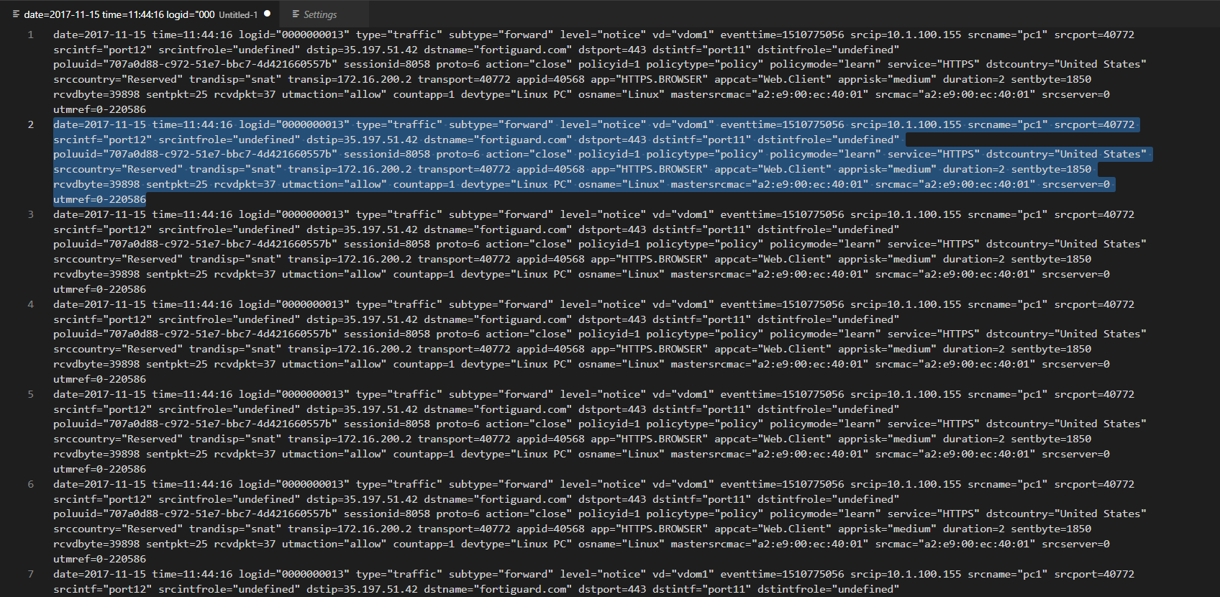
1. Current Constructing Mappings
Online Documentation
Internal Documentation
ECS Field | Syslog/Dark Trace Field Name | Example Output | Comments
@timestamp | "@timestamp" |  | This should be the time the event was parsed into Elastic, in UTC
tenant.name | N/A |  | Manually set in the router, don't change after this
event.start | syslog header timestamp | <165>Nov 22 09:02:3210.107.250.1 {​​​​​"creationTime":... | This should be the original device/event timestamp from the syslog header, in UTC
event.created | creationTime | 1542877373000 (requires appropriate conversion) | This should be the time of the event from within the contents of the event, in UTC The timestamp that the record of the breach was created. This is distinct from the "time" field.
event.timezone | N/A | specific to customer | This should be the original device/event timezone eg "AEST" and may need to be manually specified at parsing time based on customer
Sample Log
Notes:
The current process for construction of mappings is a tedious.
It requires looking at raw logs along with its documentation, [Click] then using this information to deduce the corresponding input - output mappings creating an internal document.

Slide 5

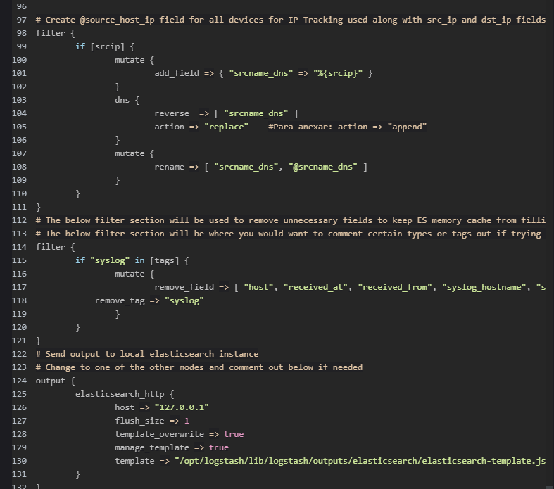
2. Normalising Live Data
Internal Documentation
Automation
ECS Field | Syslog/DarkTrace Field Name | Example Output | Comments
event.original | N/A | Raw Message
@timestamp | "@timestamp" |  | This should be the time the event was parsed into Elastic, in UTC
tenant.name | N/A |  | Manually set in the router, don't change after this
event.start | syslog header timestamp | <165>Nov 22 09:02:3210.107.250.1 {​​​​​"creationTime":... | This should be the original device/event timestamp from the syslog header, in UTC
event.created | creationTime | 1542877373000 (requires appropriate conversion) | This should be the time of the event from within the contents of the event, in UTC The timestamp that the record of the breach was created. This is distinct from the "time" field.
event.timezone | N/A | specific to customer | This should be the original device/event timezone eg "AEST" and may need to be manually specified at parsing time based on customer
Splunk Mapping Configuration
ECS Field | Syslog/Dark Trace Field Name | Example Output | Comments
@timestamp | "@timestamp" |  | This should be the time the event was parsed into Elastic, in UTC
tenant.name | N/A |  | Manually set in the router, don't change after this
event.start | syslog header timestamp | <165>Nov 22 09:02:3210.107.250.1 {​​​​​"creationTime":... | This should be the original device/event timestamp from the syslog header, in UTC
event.created | creationTime | 1542877373000 (requires appropriate conversion) | This should be the time of the event from within the contents of the event, in UTC The timestamp that the record of the breach was created. This is distinct from the "time" field.
event.timezone | N/A | specific to customer | This should be the original device/event timezone eg "AEST" and may need to be manually specified at parsing time based on customer
Notes:
This internal documents is then used to normalising live data.
Which requires, reading and interpreting raw log files, and then taking the mapping previously constructed, and implementing them in code, or configuration file.
[Click] However, what if these documents were more easily readable to programs, and then the config files could be produced automatically.

Slide 6
Motivation
Simplify the process
Reduce time and effort
Improve accuracy
Easier Automation
Notes:
The motivation for this project is to simplify the cluttered nature of the current process, reduce the time expenditure on log normalisation, improve accuracy and allowing automation of tasks.

Slide 7
The Process: Data Normalisation
Our Solution
Extension
Constructing Mappings
Normalising Live Data
Notes:
We believe our solution can address these pain points.
However firstly we narrowed the scope of the project to handle the core problem due to time requirements and complexity.
Which is Mapping an input field to and output field, as nothing can be done until this step is completed.
When this is accomplished this information can be used for manually or automatically normalising live data in the future.

Slide 8
Our Solution: Core Functionality
Normalising input and output fields
Typing of Fields
Types represent regular expressions
UINT32
(.*)
source_ip source_destination
dateTime as EPOCH dateTime as UTC
IPv4 \b((25[0-5]|2[0-4][0-9]|[01 ]?[0-9][0-9]?)(\.|$)){4}\b 149.167.143.3: Match Bananas: No Match
Notes:
Our solution is to provide a wiki of normalisation information.
It consists of specifying input and output for mappings. Such as source ip maps to source destination
Specifying what type of data is for each field, like whether a dateTime is EPOCH or UTC, and this can help converting a type from one to the other.
Lastly types based off regular expressions, for example IPv4 has this regular expression which we can check against data, this allows data validation.

Slide 9
Our Solution: UX Functionality
Suggestion of mappings
Cloning existing mappings and formats
Validation against sample data
Notes:
Moving on we also focused on the user experience.
Such as suggestive mapping capabilities as well as being able to clone existing mapping or formats, to skip repitive work. As well as using local sample data to be validated against the types using regular expressions, to improve accuracy and confidence.

Slide 10
Extensions
Generating Splunk/Elastic config files automatically
Read and detect different log formats
Integrated Ingestion of Log files
API access of documents
Generating validation code for continually integration
Notes:
We believe once this initial product is created further modules can be added to reduce the tasks of normalising data.
These were ideated from discussion with the client as well as internal team discussion.
Such as automatically generating a mapping config files for Splunk or Elastic.
Expanding the current log formats as inputs for sample data, currently only supporting JSON and CSV for this initial project.
Integrating ingestion log files directly from the data lake.
API access to the documents, this would reduce having to download the files manually
Lastly the generating validation code for continual testing and maintenance.

Slide 11
Demo
Creating a Type
1
Creating an Input Format
2
Creating a Normalisation Format
4
Validating Input Format
3
Notes:
We now run through 4 common scenarios of the process of normalising a new log.

Slide 12

Questions
Notes:
Any questions

